Slide 1
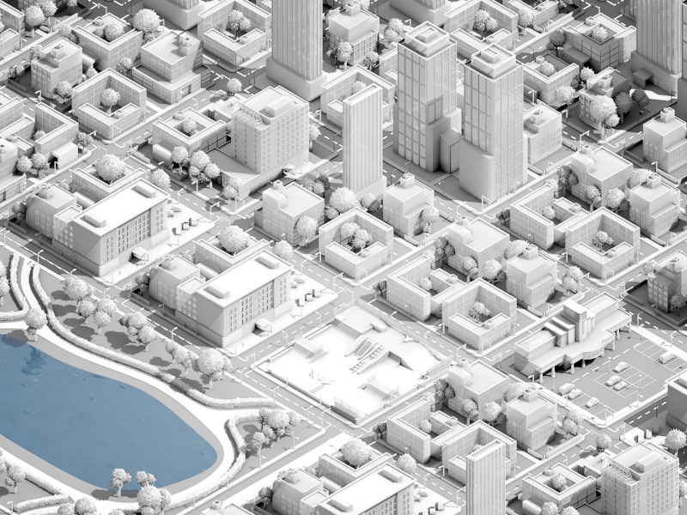

Slide 2
URBANEYYA Home | My Account | Notifications | Account Setting | Help
Urban Tools
© Urban Control Panel
© Discussion Hall
© Urban Wallet
© Urban Library
© Social Life
© Build 3D Environment
© Develop the Urban Area
© Account Setting
Footer

Slide 3
URBANEYYA Home | My Account | Notifications | Account Setting | Help
Urban Tools
© Urban Control Panel
© Discussion Hall
© Urban Wallet
© Urban Library
© Social Life
© Build 3D Environment
© Develop the Urban Area
© Account Setting
First Last-name
Unit
Building
NH/Hara
District
City
Country
10
3000 Nahdat Alsharq
Al-nor
Al-bawadi
Jeddah
KSA
Hide
What to show in public that motivates contribution and collaboration with neighbors:
+ Building/unit performance
+ Projects
+ Contribution in the Neighborhood, Financial – Time and effort
+ Experience points and badges to illustrate urban design abilities
+ Personal book
+ Recent activates
+ Recent discussion
See an example: https://www.khanacademy.org/profile/kaid_703731576636172505637347/
Footer

Slide 4
URBANEYYA Home | My Account | Notifications | Account Setting | Help
Urban Tools
© Urban Control Panel
© Discussion Hall
© Urban Wallet
© Urban Library
© Social Life
© Build 3D Environment
© Develop the Urban Area
© Account Setting
Footer

Slide 5
URBANEYYA Home | My Account | Notifications | Account Setting | Help
Urban Tools
© Urban Control Panel
© Discussion Hall
© Urban Wallet
© Urban Library
© Social Life
© Build 3D Environment
© Develop the Urban Area
© Account Setting
Footer

Slide 6
URBANEYYA Home | My Account | Notifications | Account Setting | Help
Urban Tools
© Urban Control Panel
© Discussion Hall
© Urban Wallet
© Urban Library
© Social Life
© Build 3D Environment
© Develop the Urban Area
© Account Setting
Footer

Slide 7
URBANEYYA Home | My Account | Notifications | Account Setting | Help
Urban Tools
© Urban Control Panel
© Discussion Hall
© Urban Wallet
© Urban Library
© Social Life
© Build 3D Environment
© Develop the Urban Area
© Account Setting
Footer

Slide 8
URBANEYYA Home | My Account | Notifications | Account Setting | Help
Urban Tools
© Urban Control Panel
© Discussion Hall
© Urban Wallet
© Urban Library
© Social Life
© Build 3D Environment
© Develop the Urban Area
© Account Setting
Footer

Slide 9
URBANEYYA Home | My Account | Notifications | Account Setting | Help
Urban Tools
© Urban Control Panel
© Discussion Hall
© Urban Wallet
© Urban Library
© Social Life
© Build 3D Environment
© Develop the Urban Area
© Account Setting
Footer

Slide 10
URBANEYYA Home | My Account | Notifications | Account Setting | Help
Urban Tools
© Urban Control Panel
© Discussion Hall
© Urban Wallet
© Urban Library
© Social Life
© Build 3D Environment
© Develop the Urban Area
© Account Setting
Footer

